Slide 1

Creating a Culture of Health
Let's get started.

Slide 2


means added value
for employers & employees

Slide 3

HEALTHY
EMPLOYEES
HEALTHY
BOTTOM LINES

Slide 4

to helping design employee-centered health
We're committed
IMPROVED HEALTH
INCREASED ACCESS TO HEALTH PROMOTION & SUPPORT
LOWER HEALTH CARE COSTS
IMPROVED JOB SATISFACTION

Slide 5

… and reducing your employment costs
CULTURE OF HEALTH
ENGAGED EMPLOYEES
LOWER HEALTH CARE COSTS
IMPROVED RECRUITMENT

Slide 6

Creating a Culture of Health

Slide 7

A Committed Team

Slide 8
A pilot program determined to find a proven formula that will reduce cost by positively influencing the workplace culture of enrolled groups and their employees' health, well-being and engagement with the healthcare system.

Slide 9

SELECTION
Five groups were selected based on the following criteria:
Top 5
Outliers
Strong Partnership
1
Put employees first
2
Committed to creating workplace wellness culture
3
Identified health improvement opportunities
4

Slide 10

Workplace Wellness

Slide 11
Why is this an employer issue?
Health care spending
Disability coverage
Productivity
Performance
Improved atmosphere
Turnover

Slide 12

The impact of
Workplace wellness
26%
32%
27%
Reduction in health costs
Reduction in workers' compensation
Reduction in sick leave and absenteeism

Slide 13

Return on Investment (ROI)
$3.48 to $1.00
(Aldana Meta-analysis, Aldana, 2001)
$3.20 to $1.00
(The Task Force on Community Preventive Services Soler et al., 2010)
$3.27 to $1.00
(Baicker meta-analysis about reduced medical costs, Baicker et al., 2010)
$1.88–$3.92 to $1.00
(Johnson & Johnson, Henke et al., 2011)

Slide 14

Myths
Easy to change behavior
People naturally "make good decisions"
They already know what to do
They have a supportive environment

Slide 15
Chronic disease comes from:
3
BEHAVIORS
80%
DEATH
4
CHRONIC DISEASES
  1. Heart disease
  2. Type 2 diabetes
  3. Lung disease
  4. Some cancers
Lead to 80%
of death and disability and up to 86% of the costs of health care
  Tobacco use
  Physical inactivity
  Poor diet

Slide 16

UNHEALTHY EMPLOYEES CAN HURT A HEALTHY BOTTOM LINE
86%
$153B
75%
of full-time U.S. employees are overweight or have
1+ chronic conditions
in employee productivity is lost annually due
to these factors
of U.S. healthcare costs
are attributed to largely preventable chronic conditions
Source: https://www.cdc.gov/chronicdisease/resources/publications/aag/pdf/2015/aag-workplace-health.pdf
Notes:
The prevalence of chronic conditions and unhealthy lifestyle choices are key factors in rising healthcare costs; they may significantly impact presenteeism and absenteesism in the workplace, impacting productivity, engagement, and ultimately your bottom line.

Slide 17
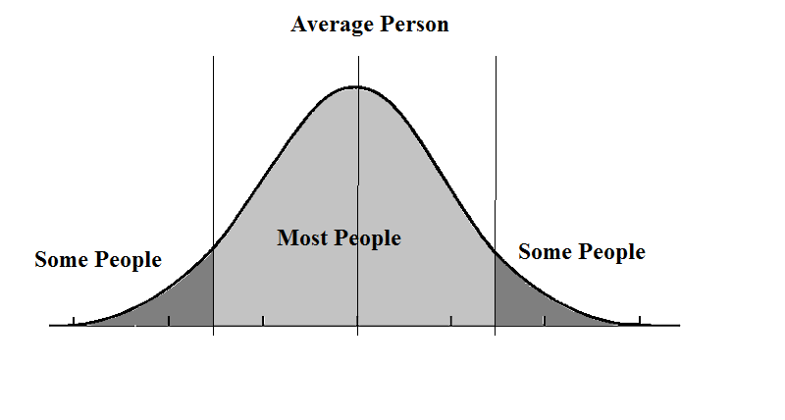
Who do you need to reach?
Environmental and Cultural Supports
Individual Behavioral Interventions

Slide 18

CREATING A CULTURE
Top 5
Outliers
Management Support
1
Employee Engagement
2
Communication Strategy
3
Cultural Support/Change
4
Structured Strategies
5

Slide 19

REACH INDIVIDUALS
Top 5
Outliers
Awareness
1
Prevention
2
Timely Intervention
3

Slide 20

Engagement & Implementation

Slide 21

Why BeWell?
Why Blue Cross?

Slide 22

Use data to identify needs
and engagement strategies
Use Our Data and yours
to precisely identify
the best opportunities
implement
programs and solutions that best support employees’ individual health needs
measure
defined outcomes,
behavior changes and employee feedback
Guide
employees with the right messages
and the right navigational support

Slide 23

What is your role?
What is our role?

Slide 24

Our Role
Expertise & Motivation
Dedicated staff
Tools
Structure & Tracking
Support
Training
Top 5
Outliers

Slide 25

Your Role
At the Start
Top 5
Outliers
Build a strong foundation
Get a baseline
  Employee
  Program
Start basic activities

Slide 26

Your Role
Future Years
Top 5
Outliers
Develop YOUR program
Annual biometrics
Funding strategy
Topic area selection
  Physical activity
  Healthy eating
  Tobacco use

Slide 27

Education & Support

Slide 28



Workplace Wellness
BeWell
Toolkit
Dedicated Program Support Staff
Wellness Tool

Slide 29



BeWell Toolkit
Resources are available to help create a plan to engage, educate and empower your employees:
Program guidelines
How-to guides
Communication templates
Promotional posters, cards and handouts

Slide 30

A Plan for Success

Slide 31

Financial Discount Opportunities
(Over 4 year time frame)
Guaranteed 5% Introduction/Baseline Discount
Up to 5% Maturity Level Discount
Maximum 7.8% Outcomes Discount, per condition (31.2% total over all four conditions); Realistic 4 year accumulated outcomes discount range (10-20%)

Slide 32
Foundation Structure
Year | Eligible Discounts
Year 1 (2021) | 3% Introduction discount
Year 2 (2022) | 2% Baseline discount + Maturity Level discount
Year 3 (2023) | 1/2 earned Outcomes-based discount for EACH measure + Maturity Level discount
Year 4 (2024) | 1/2 earned Outcomes-based discount for EACH measure + Maturity Level discount

Slide 33
Outcomes Matrix
Prevalence | % of distinct members with condition (Baseline) | Outcomes (% eligible members meeting target)
 |  | 5% - 9.99% | 10%-19.99% | 20%-29.99% | 30%-49.99% | 50%-74.99% | 75% above
 | Tier 1: 0% - 4.99% | 0.6% | 0.9% | 1.2% | 1.8% | 2.4% | 3.0%
 | Tier 2: 5% - 9.99% | 0.9% | 1.2% | 1.5% | 2.1% | 2.7% | 3.6%
 | Tier 3: 10% - 19.99% | 1.2% | 1.5% | 1.8% | 2.7% | 3.6% | 4.5%
 | Tier 4: 20% - 39.99% | 1.5% | 2.1% | 2.7% | 3.6% | 4.8% | 6.0%
 | Tier 5: 40% above | 1.8% | 2.5% | 3.6% | 4.8% | 6.3% | 7.8%
Condition | Prevalence (80% of 100 total members) |  | Tier | Outcome
Blood Glucose/A1c | 12.5% | 10 out of 80 | T3 | 4 out of 10 | 40% | 2.7%
Blood Pressure | 30.0% | 24 out of 80 | T4 | 4 out of 24 | 16.7% | 2.1%
Tobacco Use | 5.0% | 4 out of 80 | T2 | 3 out of 4 | 75.0% | 3.6%
BMI | 40.0% | 32 out of 80 | T5 | 17 out of 32 | 53.1% | 6.3%
 |  |  |  |  |  | 14.7% / 2 = 7.35% per year

Slide 34
Example Group
Group of 100 contracts with avg. CPC = $600 for an annual Total Cost of $720,000
Year 1: 2021 | Year 2: 2022 | Year 3: 2023 | Year 4: 2024
3% Introduction Discount | 2% Baseline Discount + 1% Maturity Level Discount | 7.35% Outcomes Discount + 1.25% Maturity Level Discount | 7.35% Outcomes Discount + 1.75% Maturity Level Discount
3% | 3% | 8.6% | 9.1%
$21,600 | $21,600 | $61,920 | $65,520
4-year total discounts (23.7%) = $170,640

Slide 35

Where are you now?
What are your barriers?
Where are you going?
How can we get there?

Slide 36
BeWell Team
BeWell@bcbsks.com

