Slide 1
Kansas Preferred Blue Medicare Advantage 101
January 2020
Notes:
Welcome to the Kansas Preferred Blue Medicare Advantage 101 Webinar!

Slide 2
Kansas Preferred Blue Medicare Advantage
Agenda
Welcome
Map (Network Counties)
Member ID Cards
Availity
Policies
Medical Policy Hierarchy
Prior Authorizations
Claim Filing
Appeals
Notes:
Welcome
Introductions
Housekeeping – Mute phones
Questions – How to send us your questions during the webinar
Webinar available on bcbsks.com under Education & Workshops
Review the Agenda

Slide 3
Kansas Preferred Blue Medicare Advantage
Map
Jasdlfkjs;lkdfj ls;adjfp';slk df
;lsk e ljkw';
Notes:
14 Counties : Jackson
Pottawatomie
Shawnee
Wabaunsee
Osage
Douglas
Jefferson
Reno
Harvey
Butler
Sedgwick
Kingman
Sumner
Cowley
Territory may be expanded outside of these counties in 2021

Slide 4
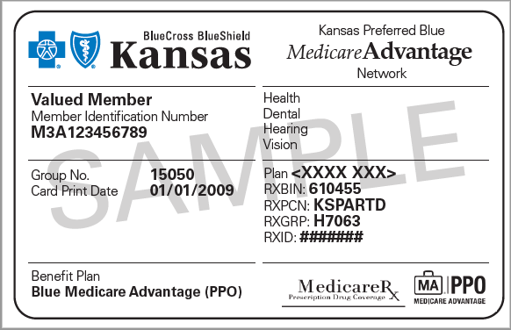
Kansas Preferred Blue Medicare Advantage
Member Card
Notes:
This card is an example of a Standard Plan member identification card

Slide 5
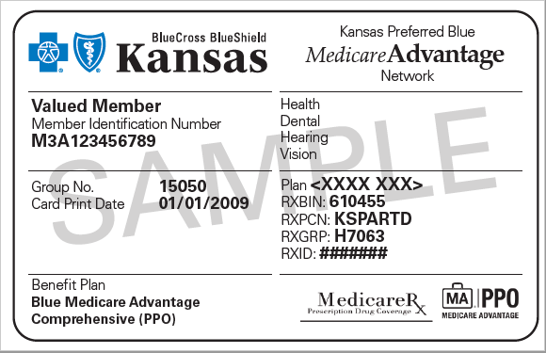
Kansas Preferred Blue Medicare Advantage
Member Card
Notes:
This is an example of a Comprehensive Plan member identification card, indicated in the lower left corner of the card. This is an optional plan available for purchase by members.

Slide 6
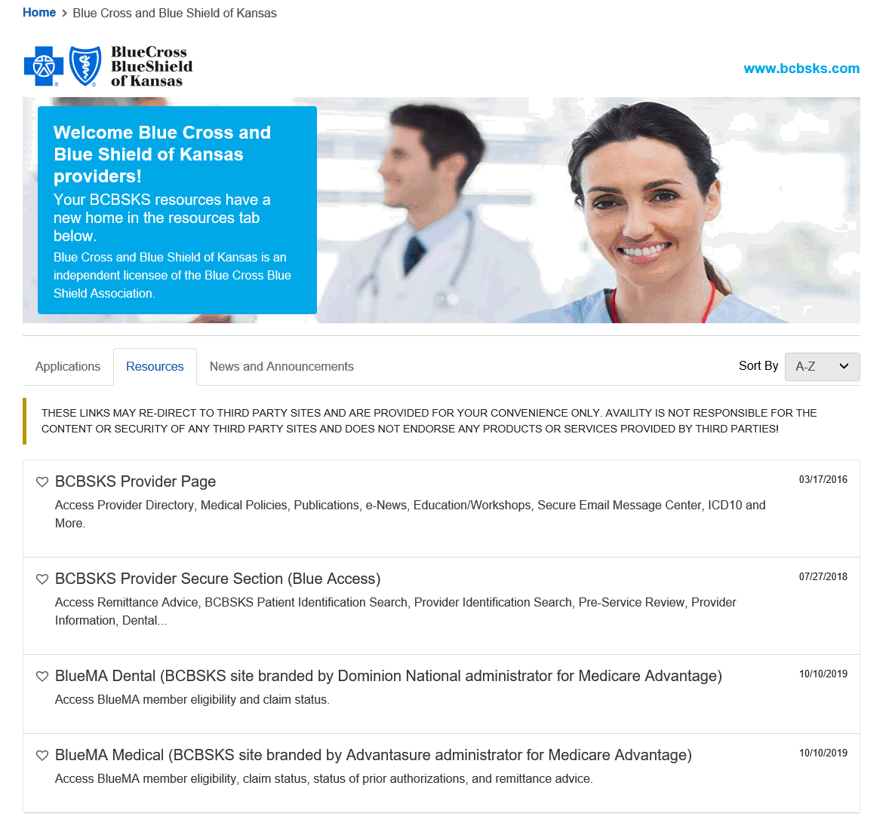
Kansas Preferred Blue Medicare Advantage
Availity
Notes:
Accessing MA eligibility and claims status is available via Availity through Payer Spaces.

Slide 7
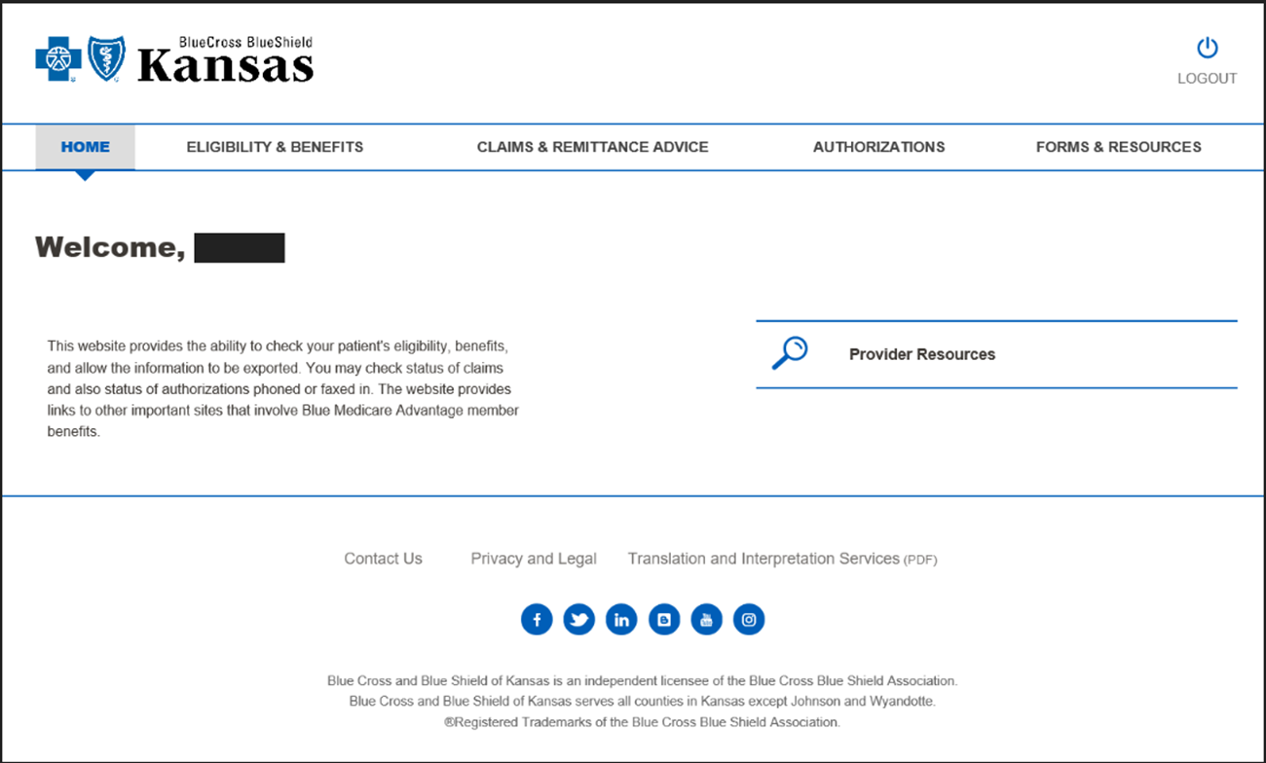
Kansas Preferred Blue Medicare Advantage
Notes:
Available from this screen is Eligibility & Benefits, Claims & Remittance, Authorizations, and Forms & Resources (Provider Manual)

Slide 8
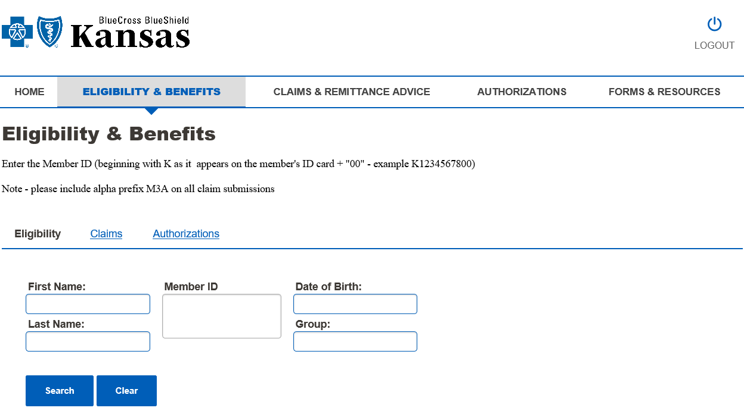
Kansas Preferred Blue Medicare Advantage
Notes:
You can search for eligibility with the following:
First Name, Last Name and Date of Birth
Or
The Member ID# listed on the Member's ID Card. Please note, you will search by member id# by dropping the alpha numeric prefix of "M3A" and adding "00" on the end.

Slide 9
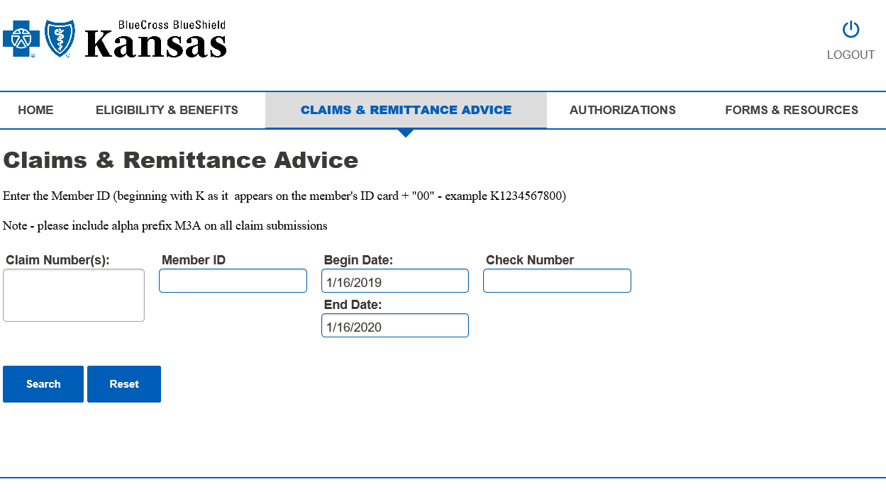
Kansas Preferred Blue Medicare Advantage
Notes:
Here you can search for claim status by entering the members ID# (drop the M3A prefix and add "00" to the end) and date of service.
You can also search by the claim numbers. You can add multiple claim numbers but each claim number must be on it's own line.
RA's can be accessed using the date ranges or check number.

Slide 10
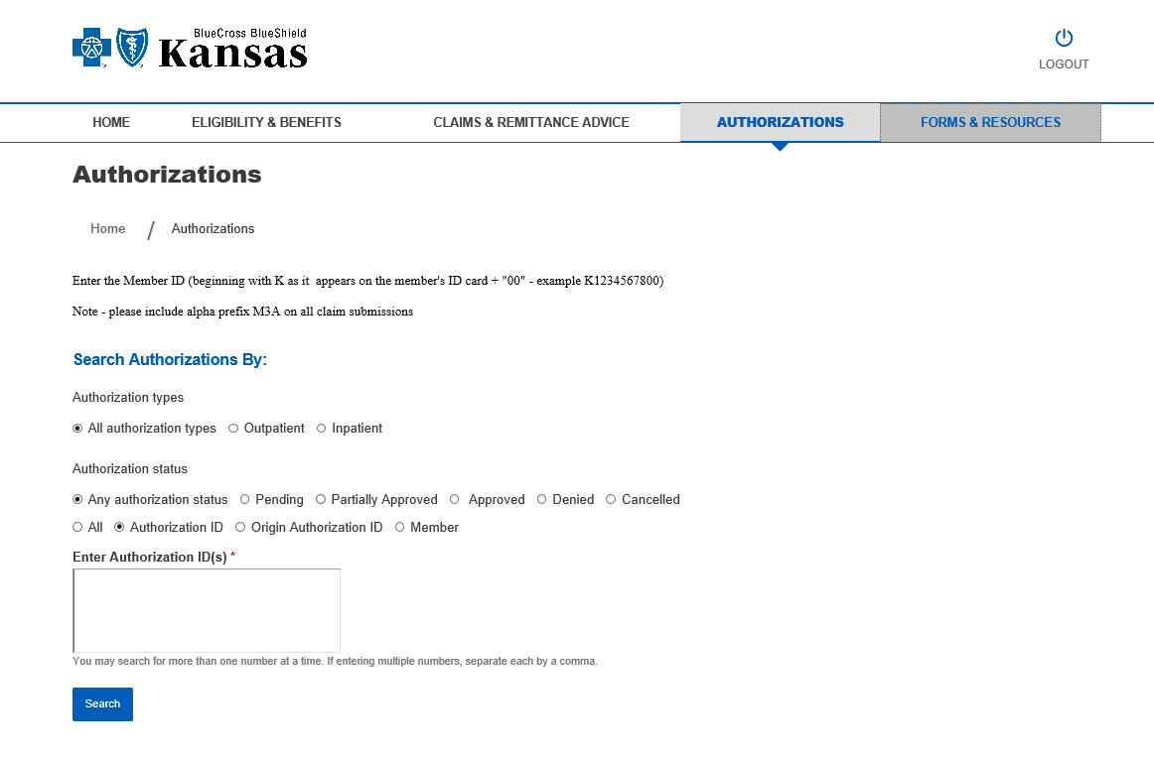
Kansas Preferred Blue Medicare Advantage
Notes:
Authorization status can be checked online. Results will be given to you for your entire facility for either the "Date of Service" or the "Date of Request" and whatever date range you choose. You can choose to see all authorizations, or you can narrow your search to only authorizations that are: pended, partially approved, approved, denied or cancelled.
You will be able to check authorizations for a individual member by member ID# (If you do not have the Member ID#, you can search by the member's SSN and or with their first and last name and date of birth)
Authorizations are also able to be checked by the Authorization ID (multiple Authorization IDs can be listed but each number has to be listed on it's own line.
Point out Forms & Resources Tab- This tab will take you directly to all the MA Forms and Resources that are available on our website.

Slide 11
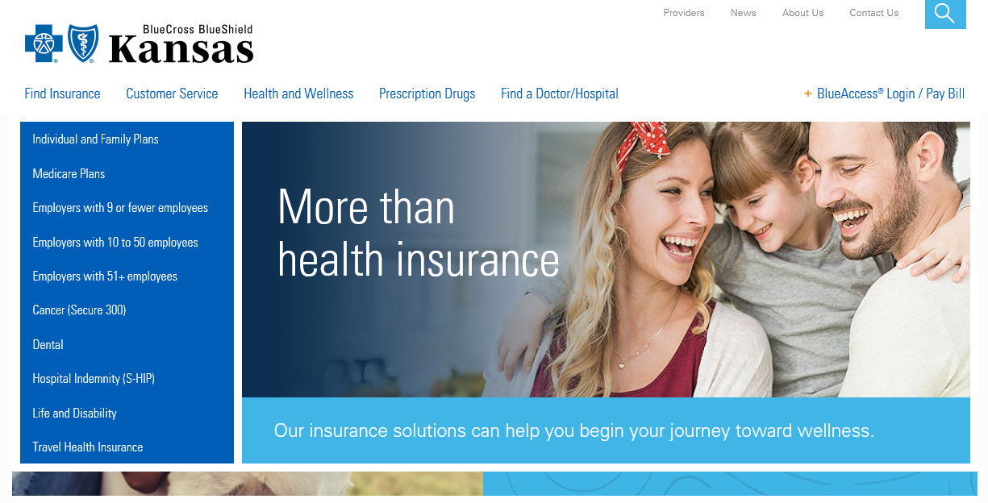
Kansas Preferred Blue Medicare Advantage
Accessing MA Provider Manual/Resources
Notes:
Another way to access the Medicare Advantage Provider Manual, Forms and Resources is to visit our website- www.bcbskss.com and select "Providers" in the upper right hand corner of the website.

Slide 12
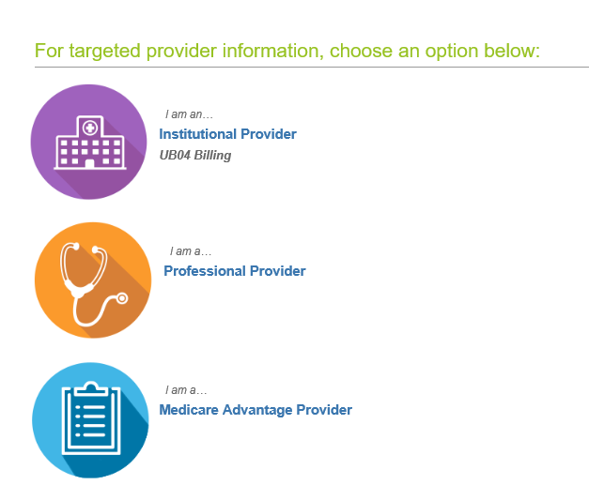
Kansas Preferred Blue Medicare Advantage
Notes:
Select "I am a…. Medicare Advantage Provider"

Slide 13
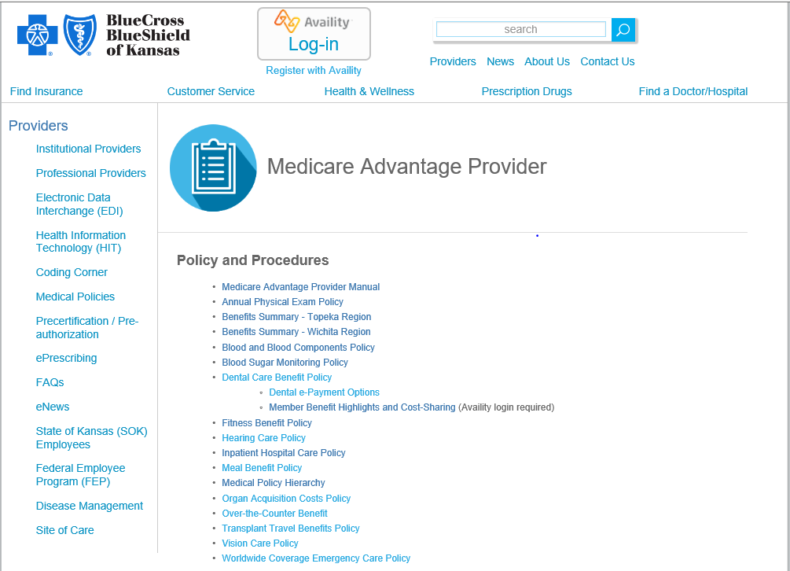
Kansas Preferred Blue Medicare Advantage
Notes:
In addition to being able to access the Medicare Provider Manual you can also access:
Policies and Procedures
Medical Management Resources
Education (Newsletters & Webinars)
Forms

Slide 14
Kansas Preferred Blue Medicare Advantage
Policies
Annual Physical Exam
Blood & Blood Components
Blood Sugar Monitoring (A1C claim filing requirement)
Inpatient Hospital Care
Notes:
There are several polices on the website, however, we are addressing these 4 specifically. For more detiled information, please see the Policy and Procedure section of the website.
Annual Physical Exam: Medicare Advantage pays for an annual physical exam with no cost share to the member
Blood & Blood Components: BCBSKS will pay for the first 3 pints of blood beginning with the cost of the 1st pint of whole blood whether provided in an inpatient or outpatient setting.
Blood Sugar Monitoring: When billing the HgbA1c lab test CPT codes 83036 and 83037, providers must also bill the associated CPT Category II code that represents the result of the test in the form of a range of values. Blue Cross and Blue Shield of Kansas (BCBSKS) will not reimburse physician offices for lab services performed for Blue Medicare Advantage members without submission of the appropriate CPT II code.
Inpatient Hospital Care: BCBSKS will provide at least the same level of benefit coverage as Original Medicare (Part A and Part B) and may provide enhanced benefits beyond the scope of Original Medicare within a single health care plan. This policy addresses: Guidelines for an inpatient hospital stay, what Original Medicare would cover, conditions of payment, reimbursement, member benefits for inpatient care, and billing instructions.

Slide 15
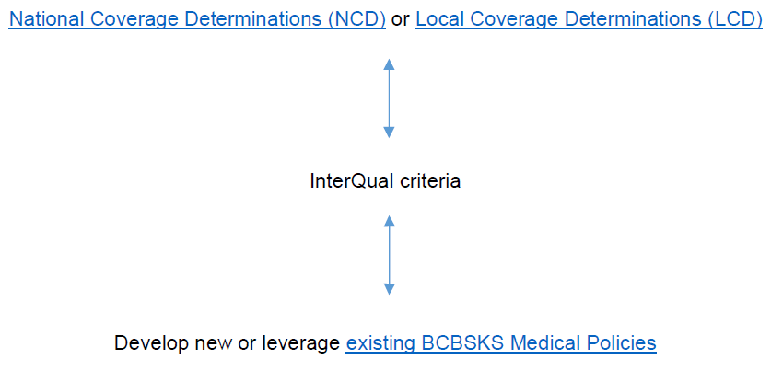
Kansas Preferred Blue Medicare Advantage
Medical Policy Hierarchy
Notes:
BCBSKS will first reference existing National Coverage Determinations (NCD) or Local Coverage Determinations (LCD). If neither of these exist, BCBSKS will reference InterQual criteria, if available. If there no InterQual criteria is available for the service, BCBSKS will develop a medical policy or leverage internal existing medical policies.

Slide 16
Kansas Preferred Blue Medicare Advantage
Prior Authorization
What services will require prior authorization for Medicare Advantage members?
What services will require prior authorization for Medicare Advantage members?
Inpatient Admissions
Acute Care
Rehabilitation
Skilled Nursing Facilities
Long-Term Acute Care
Mental Health/Substance Abuse
Inpatient Admissions
Acute Care
Rehabilitation
Skilled Nursing Facilities
Long-Term Acute Care
Mental Health/Substance Abuse

Slide 17
Kansas Preferred Blue Medicare Advantage
How do I submit a prior authorization?
How do I submit a prior authorization?
Inpatient Admissions
Acute Care
Rehabilitation
Skilled Nursing Facilities
Long-Term Acute Care
Inpatient Admissions
Acute Care
Rehabilitation
Skilled Nursing Facilities
Long-Term Acute Care
Inpatient Admissions
Mental Heath/ Substance Abuse
Inpatient Admissions
Mental Heath/ Substance Abuse
WebPass
https://webpass.ndbh.com
Phone
800-325-6201
Form via Fax
877-281-9089
Mail
PO Box 260875 Plano, TX 75026-0875

Slide 18
Kansas Preferred Blue Medicare Advantage
How can I check the status of a Prior Authorization?
How can I check the status of a Prior Authorization?
Phone
800-325-6201
Medicare Advantage Provider Portal
Accessed through Availity>Payer Spaces> BlueMA Medical
All inpatient mental health/substance abuse is completed by New Directions Behavioral Health status can be checked on WebPass.

Slide 19
Kansas Preferred Blue Medicare Advantage
What are the time frames for obtaining a Prior Authorization?
What are the time frames for obtaining a Prior Authorization?
Type of Admission | Time Frame for Prior Authorization
Emergency Admission (through ER) | As soon as possible (same day/next day)
Elective Admissions | 14 days prior to elective inpatient stay
Obstetrical Admissions | 1 day following discharge
Notes:
Retro- Authorization will be reviewed on a case by case basis.

Slide 20
Kansas Preferred Blue Medicare Advantage
Claim Filing
Submit electronic claims to BCBSKS, Payer ID 47163
Submit paper claims to:
Kansas Preferred Blue Medicare Advantage
P.O. Box 239
Topeka, KS 66629
Non-Kansas providers, file with the local Blue plan
Timely filing
Notes:
No changes as far as who and where you submit your claims to.
Timely filing – 365 days after the date on which the services were provided. Whenever the last day for timely filing of a claim falls on a Saturday, Sunday, Federal non-workday or legal holiday, the claim will be considered filed timely if it is filed on the next workday.

Slide 21
Kansas Preferred Blue Medicare Advantage
Pre and Post-Service Appeals & Payment Disputes
First-Level
Call Provider Services
Submit within 60 days of the initial determination
Pre-Service appeals will be reviewed and responded to within 30 days of receipt
Post-Service appeals will be reviewed and responded to within 60 days of receipt
Notes:
Additional appeals rights are outlined in Chapter 15 of the Medicare Advantage Provider Manual.

Slide 22
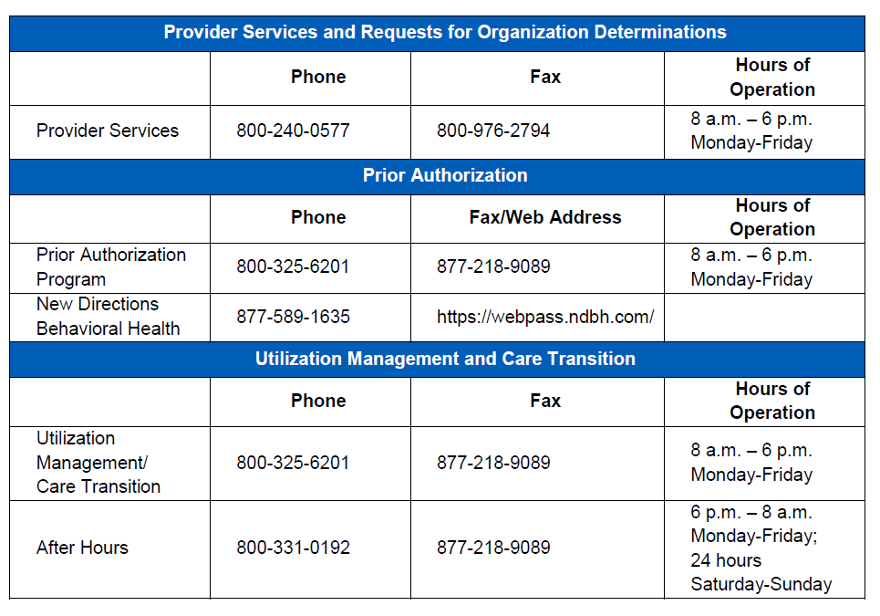
Kansas Preferred Blue Medicare Advantage
Contact Information
Notes:
Contact information is found in Chapter 2: General Information in the Medicare Advantage Provider Manual
Please note, there is an after hours number for prior authorizations.

Slide 23
Jessica L. Moore
Education and Communication Coordinator, Institutional Provider Relations
785-291-7236
Jessica.moore@bcbsks.com

