Slide 1

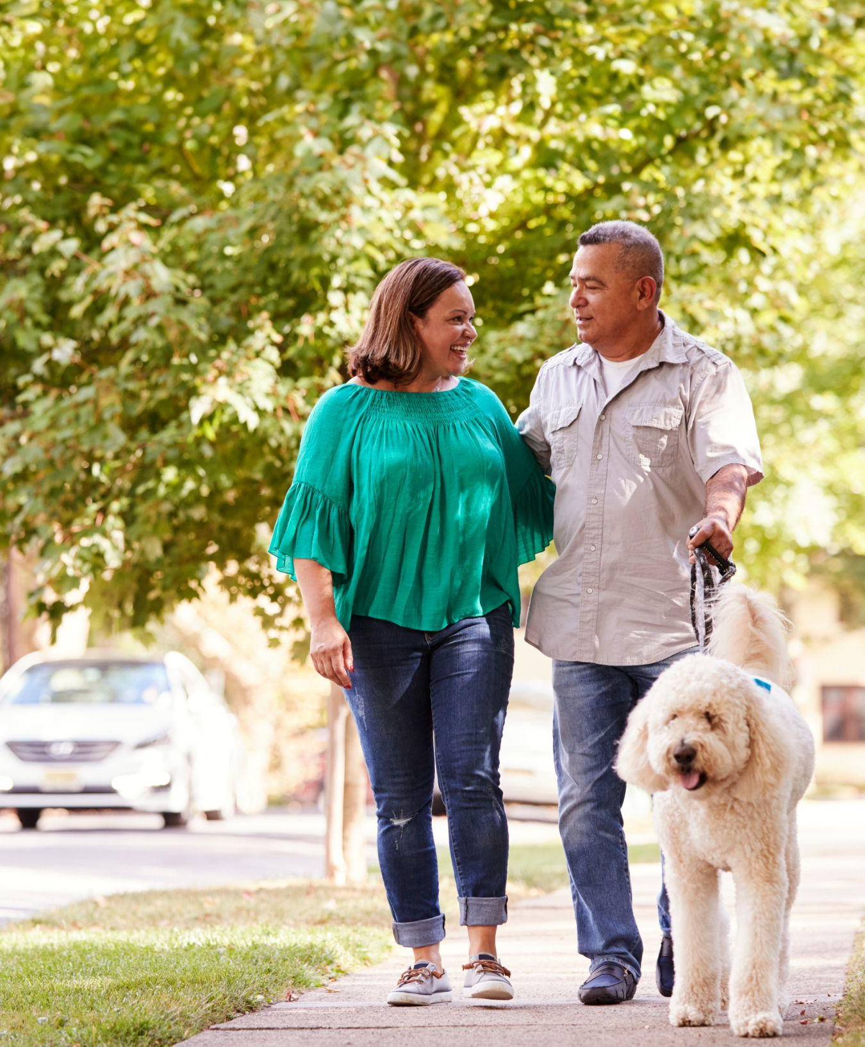

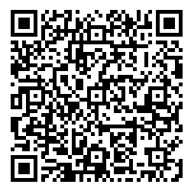
Type 2 Diabetes Reversal
Redefine what’s possible
Learn how food can be used as medicine to reverse weight gain, high blood sugar, and medication needs.
Nutrition therapy is $0 for individuals & dependents with a qualifying condition.
Learn more:
virtahealth.com/join/bcbsks
Blue Cross and Blue Shield of Kansas is an independent licensee of the Blue Cross Blue Shield Association. BLUE CROSS®, BLUE SHIELD® and the Cross and Shield Symbols are registered service marks of the Blue Cross Blue Shield Association, an association of independent Blue Cross and Blue Shield Plans. Blue Cross and Blue Shield of Kansas contracts with Virta Health to provide a type 2 diabetes reversal program to members. Virta Health is unaffiliated with Blue Cross and Blue Shield of Kansas.

